Slide 1
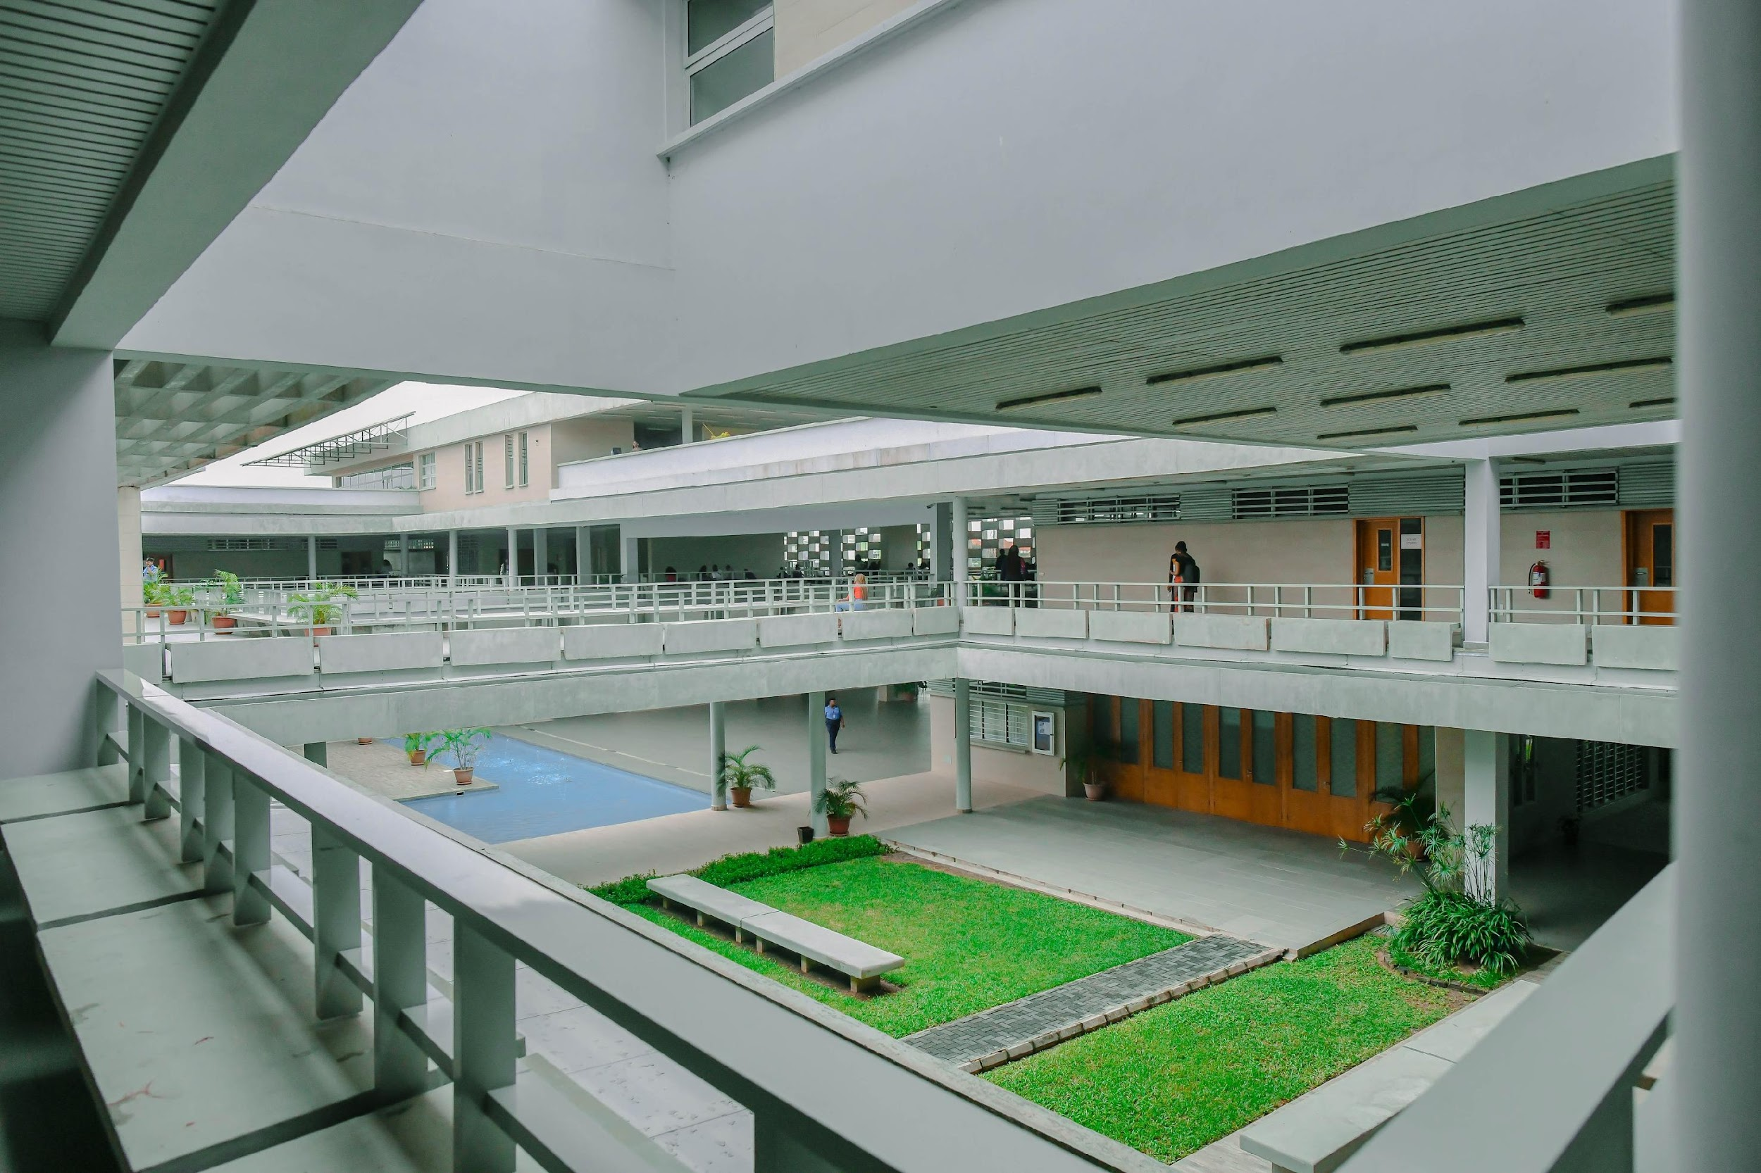

CSC 411 ML Lecture 9
Unsupervised Learning and Model Selection and Hyperparameter Tuning
Bunmi Akinremi
28th Apr 2026
AI Engineer
Classroom 1

Slide 2
Brief Overview
K-Means clustering and hierarchical clustering.
Principal Component Analysis (PCA) and geometric dimensionality reduction
Cross-validation strategies
Grid vs random search
When tuning is a waste of time

Slide 3
Recap of The ML Workflow
Problem Formulation
Gather and organize data
Preprocessing, cleaning, and visualizing
Choose a model and optimize
Training: Fit a new model on the training set.
Linear Models & Regularization
Non-Parametric Models & Ensembles
Support Vector Machines
Unsupervised Learning
Model Selection, Evaluation, and Learning Theory
Model Selection and Tuning

Slide 4
Unsupervised Learning & Model Selection
Supervised Learning: Learns by using labeled data (e.g., predicting house prices).
Unsupervised Learning: Trained using unlabeled data without any guidance or predefined outcome.

Slide 5
Goals of Unsupervised Learning
Learn the structure of data (e.g., clusters or lower dimensions).
Learn the probability distribution of data to generate synthetic examples.
Learn useful representations for downstream tasks.

Slide 6
Applications in the Real World
Genomics: Grouping individuals by genetic similarity.
E-commerce: Customer and market segmentation.
Signal Processing: Independent Component Analysis (e.g., isolating voices in a crowd).

Slide 7
Unsupervised Learning: Two Main Pillars
Clustering: Grouping objects by similarity.
Dimensionality Reduction: Compressing data while retaining information.

Slide 8
K-Means Clustering
What is Clustering?
Establishing the existence of classes or clusters in data.
Prototype-Based Clustering
Each cluster is represented by a "prototype".
Usually the centroid (average) of similar points for continuous features.
Goal: Items in the same cluster are more similar to each other than to items in other clusters.

Slide 9
The K-Means Algorithm Overview
Step 1: Specify the number of clusters, k.
Step 2: Initialize k centroids randomly.
Step 3: Assign each point to the nearest centroid.
Step 4: Recompute the centroids.

Slide 10
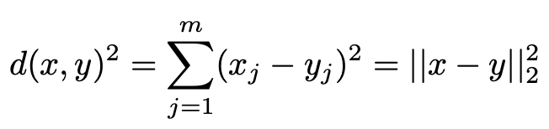
The Distance Metric
Usually relies on Squared Euclidean Distance.
Feature scaling is mandatory!

Slide 11
The K-Means Algorithm
The Objective Function (Inertia)
K-Means minimizes the Within-Cluster Sum of Squared Errors (SSE).
Also known as Cluster Inertia.
Expectation-Maximization in K-Means
Expectation Step: Assigning points to the closest current centroid.
Maximization Step: Updating the centroid to the mean of the assigned points.

Slide 12
The K-Means Algorithm
Hard vs. Soft Clustering
Drawbacks of K-Means
Hard Clustering (K-Means): A point belongs to exactly one cluster.
Soft Clustering (Fuzzy C-Means): A point has a probability of belonging to multiple clusters.
Assumes clusters are spherical.
Requires the number of clusters k to be specified a priori.

Slide 13
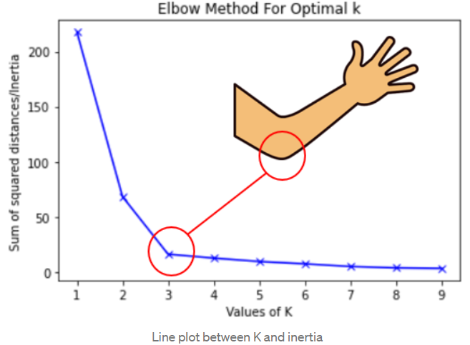
The K-Means Algorithm
The Elbow Method
How do we choose k?
Plot the Distortion (Inertia) against the number of clusters k.
Find the "elbow" where distortion begins to decrease less rapidly.
Source: Linkedin

Slide 14
Advanced & Hierarchical Clustering
Density-Based Clustering (DBSCAN)
The Initialization Problem (K-Means++)
Locates regions of high density.
Does not require specifying k a priori.
Can capture arbitrary shapes.
Random initialization can lead to poor, sub-optimal clustering.
K-Means++: A smarter way to place initial centroids far away from each other.
Failing on Non-Spherical Shapes
K-means fails on interlocking or half-moon shaped data.
Distance from centroid cannot capture curved density.

Slide 15
Introduction to Hierarchical Clustering
Organizes clusters as a hierarchical tree. Does not require specifying k upfront.
Agglomerative (Bottom-Up) Clustering
Linkage Criteria
Starts with each point as its own individual cluster.
Iteratively merges the two closest clusters until only one massive cluster remains.
How do we measure distance between groups of points?
Single linkage, Complete linkage, Average linkage, Ward's linkage

Slide 16
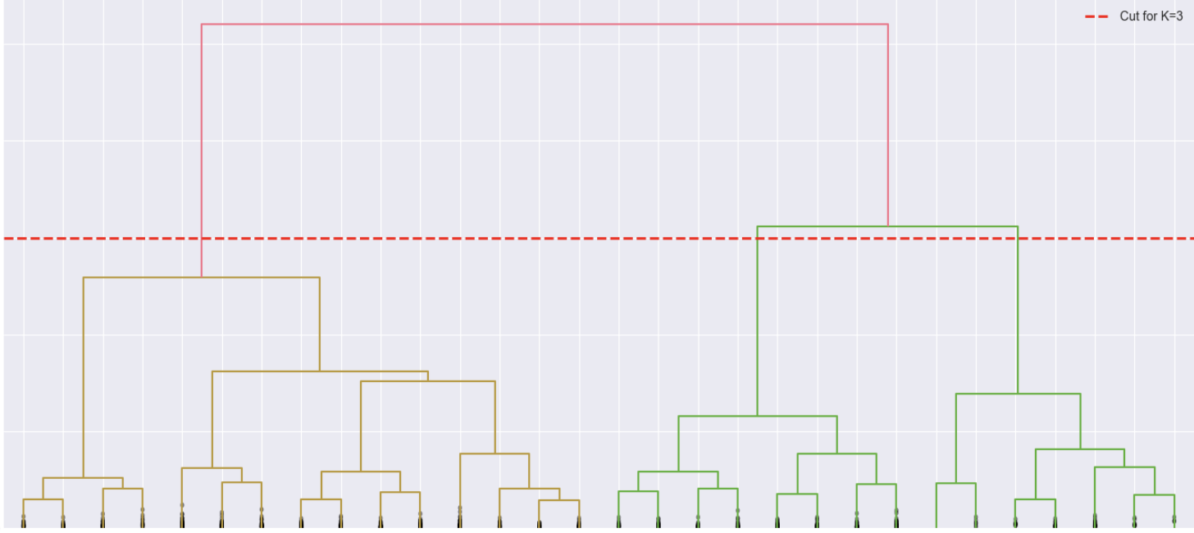
Visualizing with Dendrograms
A tree-like diagram summarizing the merges.
Allows us to visually prune the tree to choose our clusters.
Dendrograms + Heatmaps: Provides a powerful summary of feature expressions within clusters.

Slide 17





Dimensionality Reduction & PCA
The Curse of Dimensionality Revisited
High-dimensional data causes sparsity and distance breakdown.
Requires massive storage and compute time.
Feature Extraction vs. Feature Selection
Feature Selection: Keeping only the best original features, deleting the rest.
Feature Extraction: Projecting data into a completely new, compressed feature space.
Unlocking Potential. Building Responsible Leaders
www.pau.edu.ng
pau_Nigeria
Pan-Atlantic University

Slide 18
Principal Component Analysis (PCA)
An unsupervised linear transformation technique.
Goal: Find the directions of maximum variance in high-dimensional data.
Geometric Intuition of PCA
Projects data onto new, orthogonal axes (Principal Components).
PC1 captures the most variance; PC2 captures the second most, etc..
Standardize the dataset.
2. Construct the covariance matrix.
3. Decompose the matrix into eigenvectors and eigenvalues.
Unlocking Potential. Building Responsible Leaders
www.pau.edu.ng
pau_Nigeria
Pan-Atlantic University

Slide 19
Principal Component Analysis (PCA)
Eigenvectors and Eigenvalues
Eigenvectors: Define the direction of the new feature axes.
Eigenvalues: Define the magnitude (variance) along those axes.
Total and Explained Variance
Sort eigenvalues by decreasing order.
Select the top k eigenvectors to construct the projection matrix W.
PCA vs. LDA
PCA: Unsupervised. Maximizes variance regardless of class labels.
LDA (Linear Discriminant Analysis): Supervised. Maximizes class separability.
PCA in Practice: Eigenfaces
Applying PCA to facial image datasets.
Images can be accurately reconstructed using just a fraction of the principal components.

Slide 20
Model Selection & Cross-Validation Strategies
The Need for Model Selection
How do we know our model will perform well on unseen data? We must find an acceptable Bias-Variance tradeoff.
The Holdout Method
Split the data into Training and Test datasets.
Train on the training set, evaluate on the test set.
Unlocking Potential. Building Responsible Leaders
www.pau.edu.ng
pau_Nigeria
Pan-Atlantic University

Slide 21
Model Selection & Cross-Validation Strategies
The Trap of Reusing the Test Set
If we reuse the test set to tune hyperparameters, it becomes part of the training data.
Leads to massive overfitting and overly optimistic evaluations.
The Validation Split Solution
Split data into Train, Validation, and Test sets.
Tune parameters on the Validation set. Test only once at the end.
Limitations of Static Splits
A static split is highly sensitive to how the data was randomly divided.
Wastes valuable training data, especially on small datasets.

Slide 22
Grid Search vs. Random Search
Parameters vs. Hyperparameters
Grid Search
Parameters: Learned from the data (e.g., regression weights).
Hyperparameters: Set manually before training (e.g., tree depth, regularization strength C).
A brute-force exhaustive search paradigm.
Evaluates the model for every possible combination of a predefined list of values.
Randomized Search CV
The Computational Cost of Grid Search
Combinatorial explosion.
Tuning many parameters simultaneously takes massive compute time.
Draws random parameter combinations from specified sampling distributions.
More efficient than Grid Search for high-dimensional spaces.

Slide 23
When Tuning is a Waste of Time
Diagnosing Bias and Variance
We use learning curves and validation curves to diagnose models.
Plotting performance vs. sample size or parameter values.
The High Bias Trap (Underfitting)
If a model is too simple (High Bias), tuning regularization won't save it.
Getting more data is also a waste of time.
Instead: Choose a more complex model or engineer new features.
The Data Quality Problem (Garbage In)
Algorithms are limited by the information in the training data.
No Free Lunch Theorem: No algorithm is universally superior.
If features are uninformative, tuning is useless.

Slide 24
Lab 9
Lab: Structured hyperparameter experiments.
Implement GridSearchCV and RandomizedSearchCV.
Plot learning curves to diagnose bias/variance.

Slide 25
Thank you
Questions?
www.pau.edu.ng
pau_Nigeria
Pan-Atlantic University

